Slide 1
Session 8
NAD1001: INTRODUCTION TO ARCHITECTURAL DESIGN

Slide 3
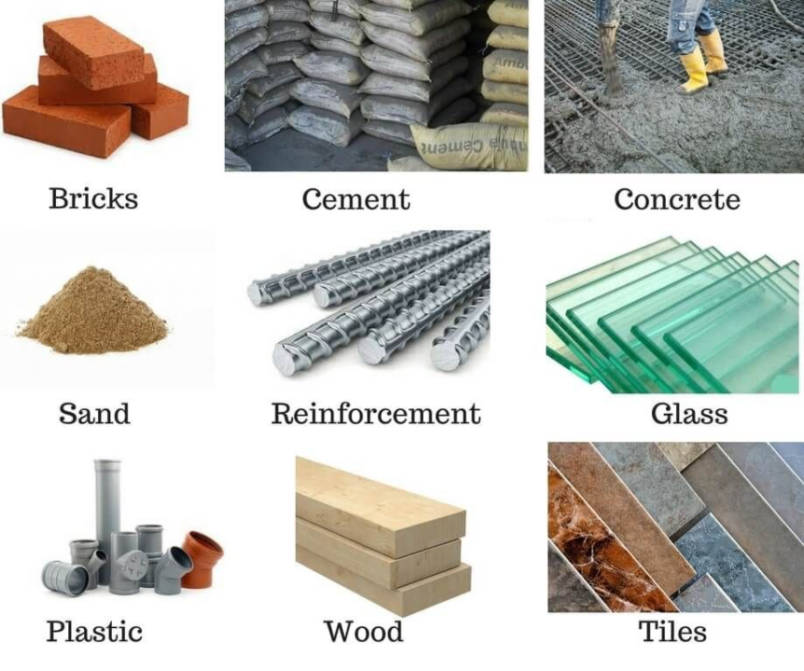
Introduction to Building Material
Building materials are substances used for construction purposes to create structures and buildings. They are essential for the structural integrity, functionality, and aesthetic appeal of a building.
https://en.wikipedia.org/wiki/List_of_building_materials
Source: Wikipedia

Slide 4
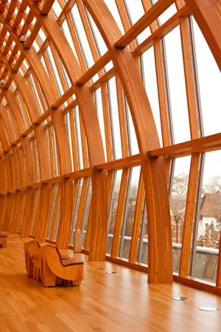
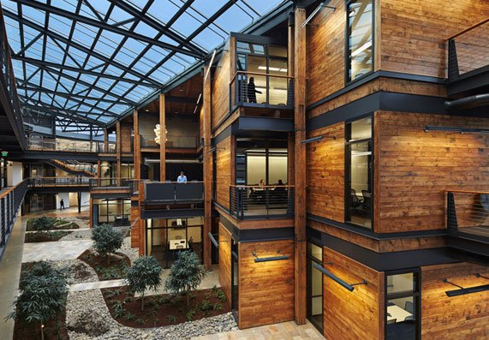
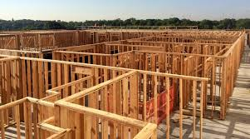
Types of Building Material – Natural
Timber can be used as many building elements.
List one of two elements?
What are some pros and cons of timber?
Source: ArchDaily

Slide 5
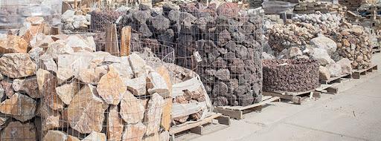
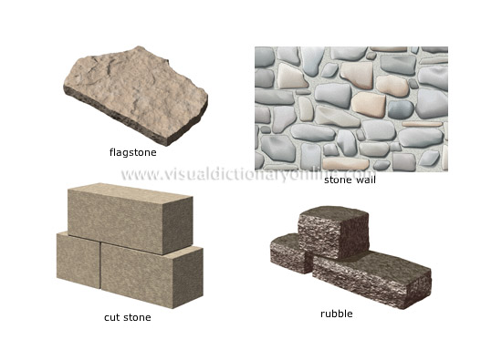
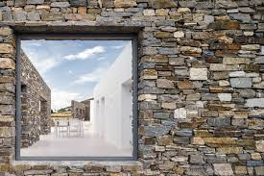
Types of Building Material – Natural
Stone – natural v.s. artificial
What are some pros and cons of stone?
Source: ArchDaily

Slide 6
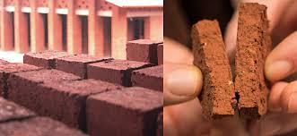
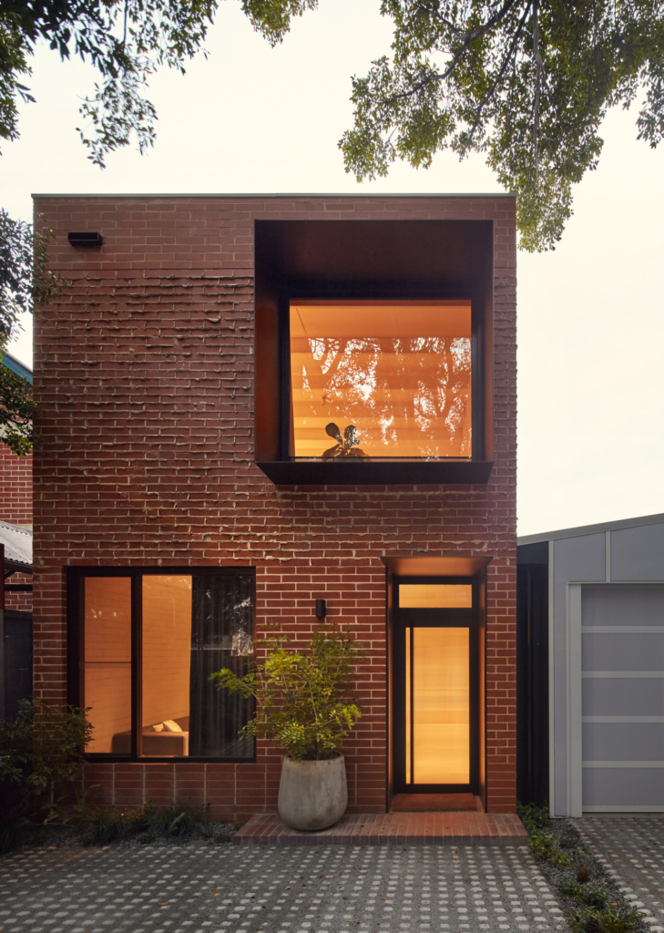
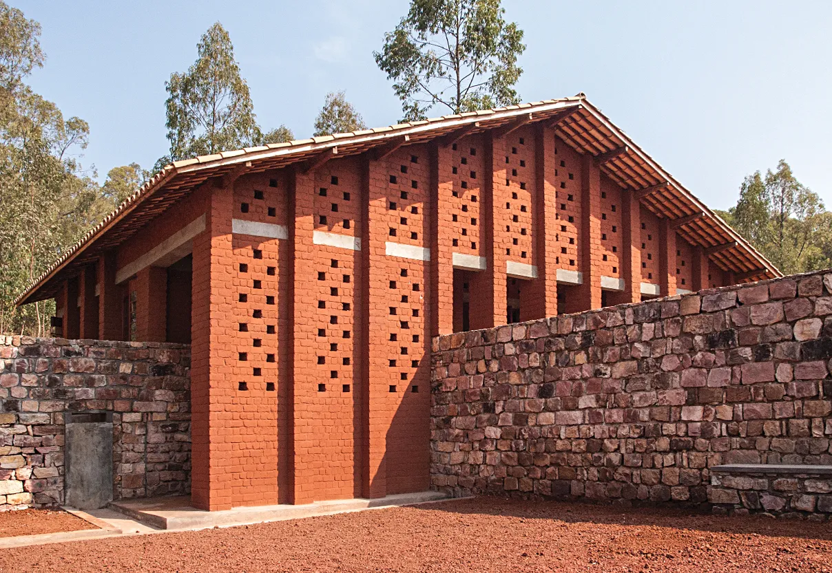
Types of Building Material – Natural
Clay
Let’s find out the composition of brick.
Is brick a sustainable material?
Source: ArchDaily

Slide 7
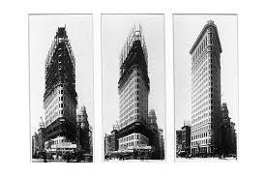
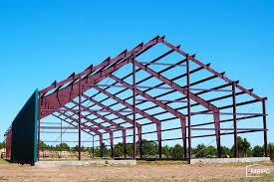
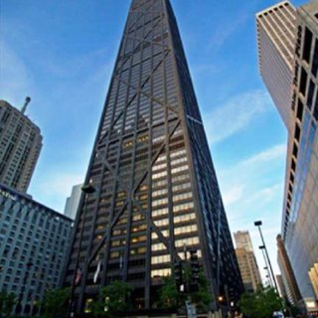
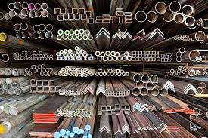
Types of Building Material – Manufactured
The Flatiron Building (originally the Fuller Building), designed by Daniel H. Burnham and built in 1902.
Steel Frame for warehouse and skyscrapers.
What’s so special about steel?
Source: ArchDaily

Slide 8

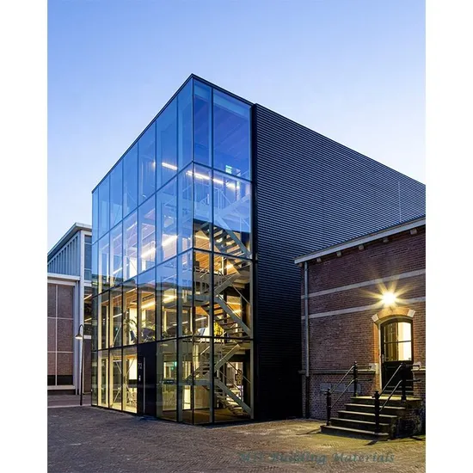

Types of Building Material – Manufactured
Glass is widely used for façade, curtain wall and window panels.
The Glass House is best understood as a pavilion for viewing the surrounding landscape.
The house design by Philip Jonson, which ushered the International Style into residential American architecture, is iconic because of its innovative use of materials and its seamless integration into the landscape.
Can this be done with other building materials?
Source: ArchDaily

Slide 9
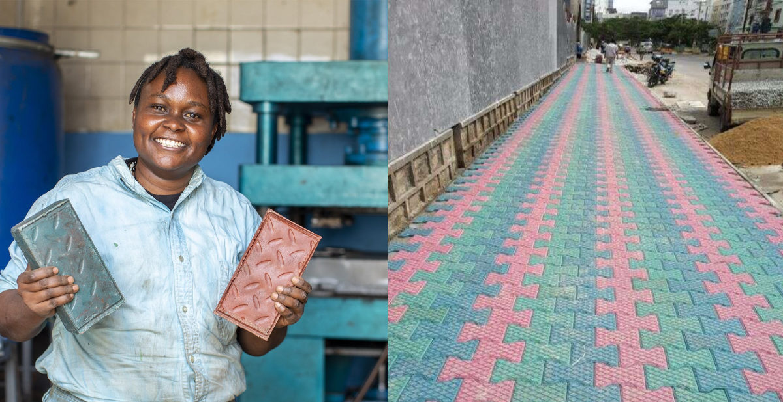
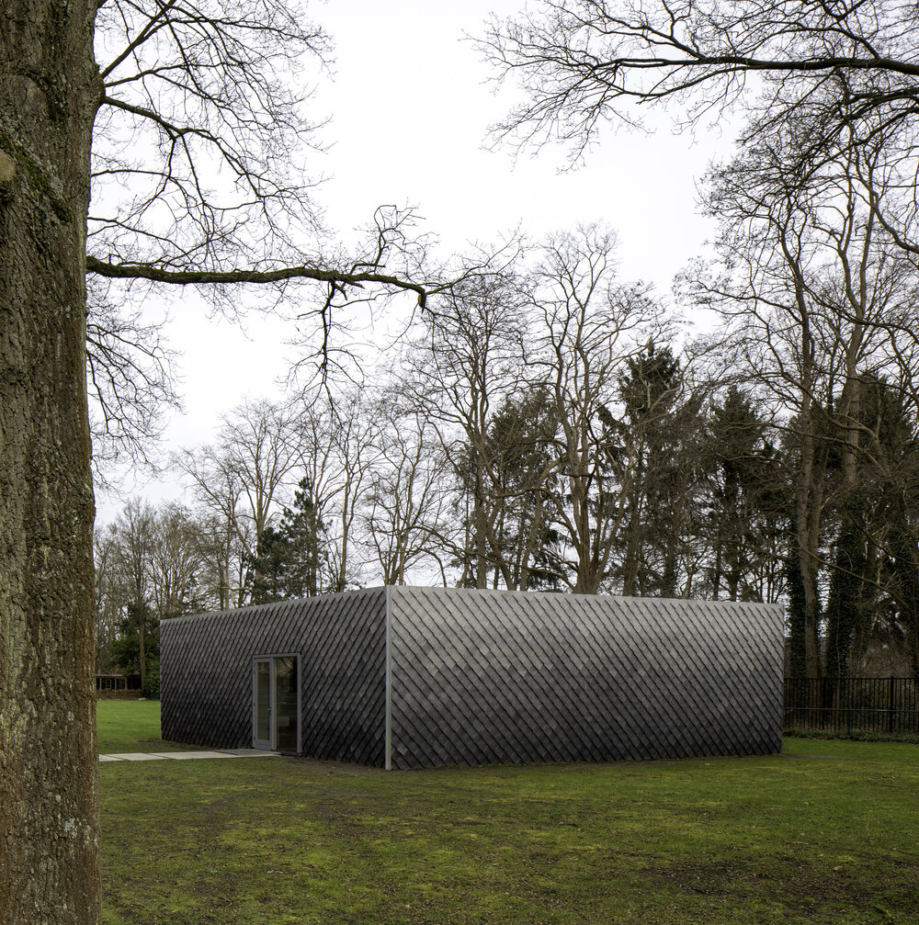

Types of Building Material – Manufactured
https://architizer.com/blog/practice/materials/plastic-as-a-building-material/
Plastic/recycled plastic as a building material.
3D print.
Source: ArchDaily

Slide 10
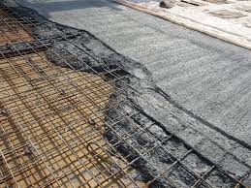
Types of Building Material – Composite
Reinforced concrete
Activity: Discuss if concrete is a sustainable material?
Source: ArchDaily

Slide 11
Material Properties and Usage
Physical properties
Mechanical properties
Chemical properties
Electrical properties
Magnetic properties
Thermal properties
https://theconstructor.org/building/properties-of-building-materials-construction/14891/
Read the above page to compare common building materials.

Slide 12
Sustainable Building Material
What do we need to consider for the sustainability of building materials?
Extracting materials
Processing materials (eg. Consume energy and water resources, produce waste)
Off-gassing
Post-consumer disposal of products (eg. Consume Landfills, pollute groundwater)

Slide 13
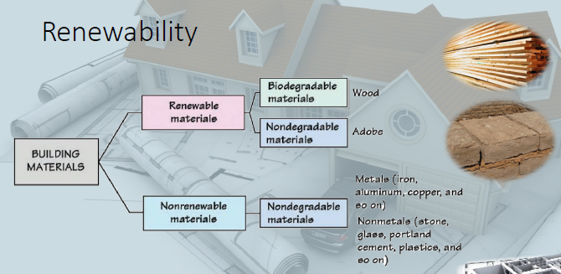
Sustainable Building Material – Green Materials
Renewable materials
Non-renewable materials
Can you categorise the commonly used construction materials, such as metal, timber, earth, glass and plastics?
Renewability
Local production
Recyclability
Recovery and reusability
Impact on the environment caused by material production
Material ingredients of product

Slide 14
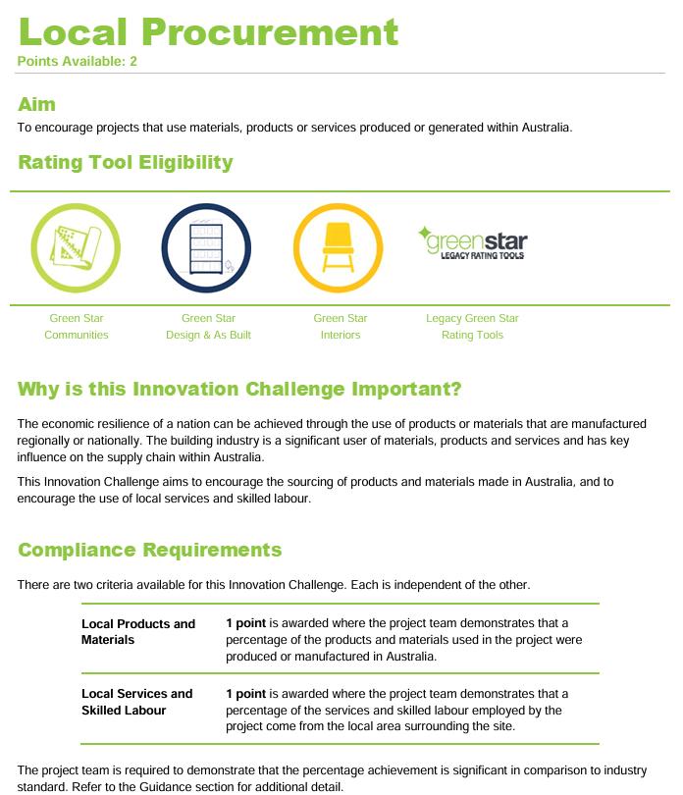
Sustainable Building Material – Green Materials

Slide 15
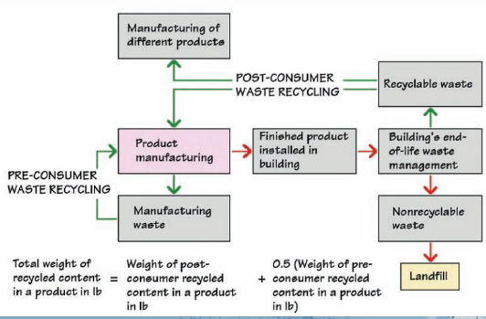
Sustainable Building Material – Green Materials
Recyclability
Source: Wikipedia

Slide 16
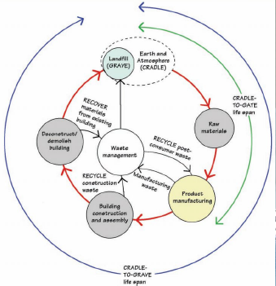
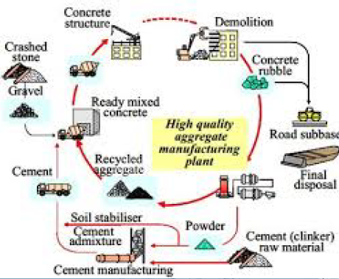
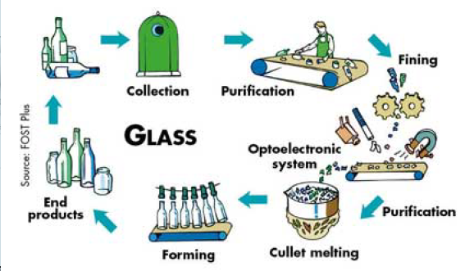
Sustainable Building Material – Green Materials
Recovery and reusability
Now do you think concrete is a sustainable material?
Reduce/Reuse/Recycle – which tenet do you think is the most important for sustainability?

Slide 17
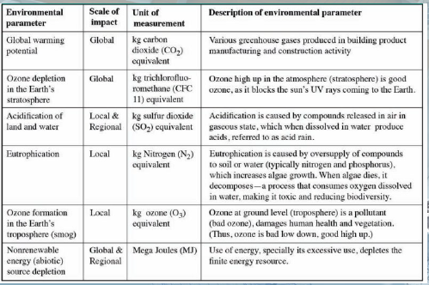
Sustainable Building Material – Green Materials
Impact on the environment caused by material production
Environmental Product Declarations (EPD)
Source: Wikipedia

Slide 18
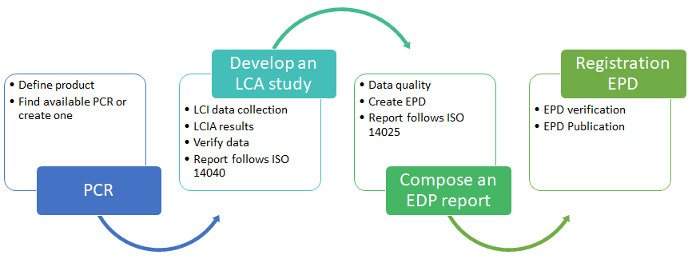
Sustainable Building Material – Green Materials
Material ingredients of products
EPD/HPD
Environmental Product Declarations /Health Product Declarations
An HPD, or Health Product Declaration, is a standardized report of a product's contents and associated health information, following the HPD Open Standard.
An Environmental Product Declaration (EPD) is a Type III environmental declaration that quantifies environmental information about the life cycle of a product. This can enable comparisons between products fulfilling the same function
Source: Wikipedia

Slide 19
Specification and Material Schedule
We will discuss documentation in session 9.
Specification and material schedule are essential parts of the documentation process.
What is the difference between two?

Slide 20
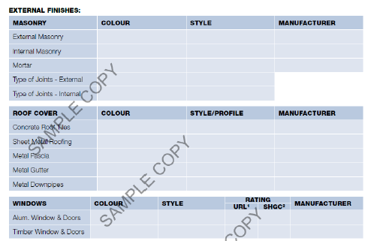
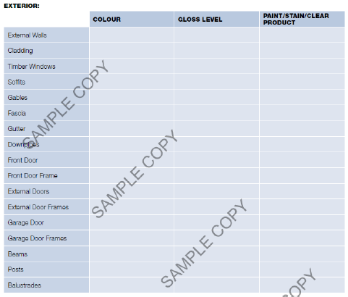
Specifications
Specifications describe the materials and workmanship required for a development. They do not include cost, quantity or drawn information, and so need to be read alongside other information such as quantities, schedules and drawings.
Housing Specification of construction requirements, including a Schedule of fittings, fixtures and finishes.

Slide 21
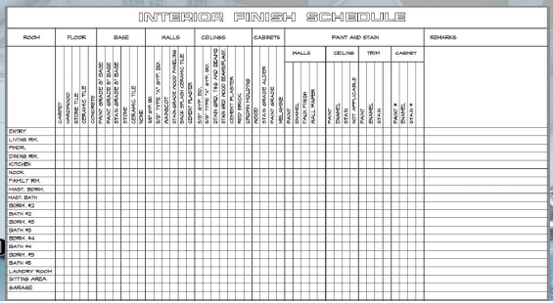
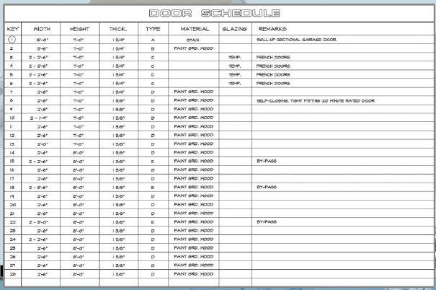
More Schedule Samples

Slide 22
Activity: Choose a Case Study and Analyse the Material

Slide 23
References
Arch Daily. (2025). Arch Daily Image. https://www.archdaily.com/

Slide 24
Thank you
Questions?

